Slide 1
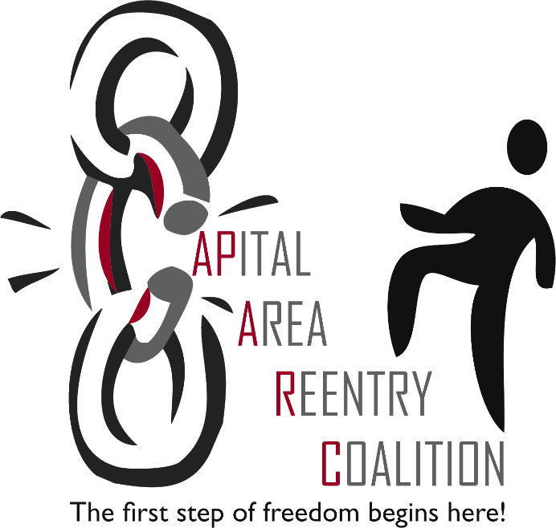
Reduction of Recidivism!
James A. Windom
Capital Area ReEntry Coalition
Notes:
I don’t know much, but I’ve learned a few things since I retired. One thing I’ve learned is…Reentry is a defaulted manifestation! In other words, 95 to 97% of all people incarcerated will return to our neighborhoods one day! The Judge sentences the person to five years in prison and unless the person does something while incarcerated to earn more time, that person will be coming home one day! Now they are home. Now what? This is where the real work begins. Reintegration is the process where the individual reconnects to family, gets a job and begins to contribute to society. However, in our guise to make our streets safer, we’ve created some very difficult hoops for our men and women to jump through once they’re released.

Slide 2
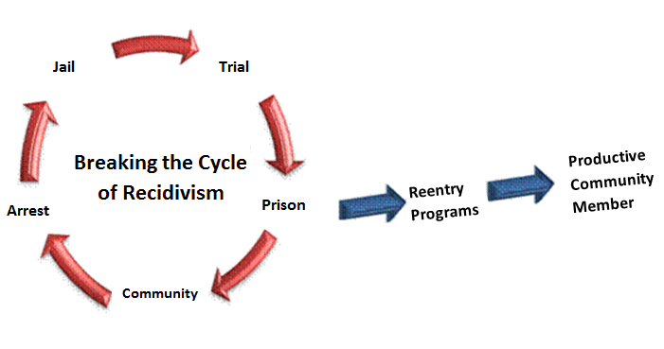
Creating Supportive Communities to Sustain Recovery and Reduce Recidivism for Re-Entry Populations
Notes:
Louisiana incarcerates over 15,000 individuals annually!

Slide 3
Overview
Offenders are Returning to your Community (what to do with them)
What is Recidivism?
  Costs
  Impact Nationally and Locally
Is there a systematic approach that is effective?
  Reentry Models
  Louisiana Prisoner Reentry Initiative (LA-PRI)
Risk, Need, Responsivity Model
  Assessment
  Evidence Based Practices
  Implementation

Slide 4

At least 95 percent of the nearly 17000 incarcerated in Louisiana state prisons will be released back to their communities at some point.
Notes:
Since most of the people incarcerated are returning at some point, it is critical for us to ensure they are equipped with all the tools for success prior to their return.

Slide 5

The Greater East Baton Rouge Parish receives approximately 100- 200 individuals from incarceration into its communities monthly.
8.0% of the state’s 17,000 annual release parole population returned to Greater East Baton Rouge Parish area.
Notes:
it costs roughly $54 dollars per day locking up someone
the state spends only $11 per day for college students state-wide

Slide 6
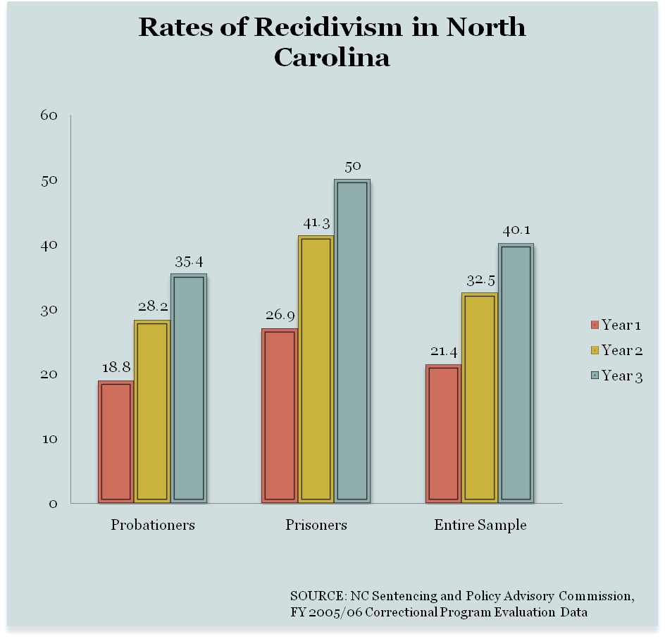
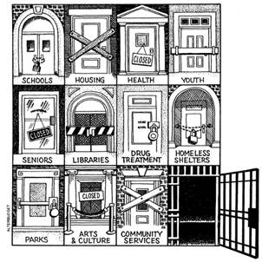
Impact: Recidivism
“Although no one supports ‘coddling criminals,’ society has a strong interest in preventing recidivism.”
-Uniform Law Comm.
The three pillars of successful reintegration are gainful employment, stable housing, and family supports. Isolated from these opportunities by informal social stigmas and collateral consequences, individuals with criminal convictions are more likely to recidivate.
Notes:
A new set of guidelines from the Department of Housing and Urban Development will make it tougher for landlords and home sellers to discriminate against applicants who have criminal backgrounds.
The guidance, announced Monday by HUD, means that a flat-out refusal to rent or sell to people who have criminal records is discriminatory because minorities—African Americans and Latinos in particular—are disproportionately arrested and imprisoned. Disparate impact is presently becoming a controversial issue due to several cities, including Kansas City, Missouri, raising the issue of the impact of housing restrictions directed at persons with felony criminal records. Several cities across the country have enacted restrictions on rental property owners regarding the general exclusion of felons. New York and Philadelphia have enacted ordinances to prevent blanket discrimination against felons and San Francisco and Seattle are presently considering such restrictions. These ordinances would make felons a protected category like the now existing seven categories. At the present time, the city of Kansas City, Missouri, has filed fair housing complaints against properties which have a general prohibition against renting to anyone with a felony record. The city's claim is that a general prohibition against renting to felons will have a disparate impact on racial minorities, specifically African-Americans and Hispanic Americans, and therefore violates the Fair Housing Act. The Human Relations Department of Kansas City, Missouri, is apparently of the opinion that a blanket prohibition on renting to a felon is a violation of Fair Housing but a restriction limited to a specific time frame would not be a violation.

Slide 7
Why Does Recidivism Matter?
Lost Productivity!
2.2 Million Incarcerated
4.7 Million Under Supervision
70 Million With Criminal Background
Lost Revenues= $80 Billion!

Slide 8
Why Does Recidivism Matter?
70 Million Person Workforce!
The 10 Top Fortune 500 U.S. Employers
Walmart = 2.2 million
McDonald = 420k
IBM = 413k
Kroger = 400k
Home Depot = 371k
Target = 347k
UPS = 336k
Berkshire Hathaway = 316k
General Electric = 305k
Yum Brands = 303k
Total Workforce = 5.4 million!

Slide 9
Why Do Collateral Consequences Matter?
70 Million Person Workforce!
The 10 Top Fortune 500 U.S. Employers
Walmart = 2.2 million
McDonald = 420k
IBM = 413k
Kroger = 400k
Home Depot = 371k
Target = 347k
UPS = 336k
Berkshire Hathaway = 316k
General Electric = 305k
Yum Brands = 303k
Total Workforce = 5.4 million!

Slide 10
Collateral Consequences:
A slippery slope toward recidivism
Returning offenders face multiple, simultaneous barriers as they embark on the process of reestablishing their lives outside prison.
Housing
Employment
Income
Family issues
Insurance
Identification needs
Medical concerns
Treatment
Lack of transportation
No support system
Education
& so much more…
Notes:
Without structured community support, the returning citizen will fail at reintegrating into society.

Slide 11
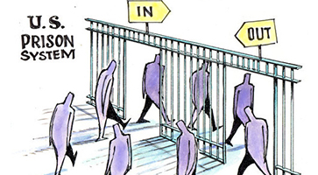
Recidivism: What is it?
Recidivism refers to a person's relapse into criminal behavior, often after the person receives sanctions or undergoes intervention for a previous crime. Recidivism is measured by criminal acts that resulted in rearrest, reconviction or return to prison with or without a new sentence following the prisoner's release.
67%
National Institute of Justice, 2014
Notes:
National Institute of Justice. "Recidivism." National Institute of Justice, 17 June 2014. Web. 1 Mar. 2017.

Slide 12
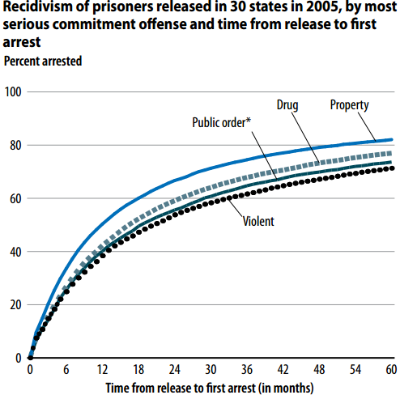
National Statistics on Recidivism
Within
3 years of release, 67.8% of released prisoners were rearrested.
Within
5 years of release, 76.6% of released prisoners were rearrested.
Notes:
Durose, Matthew R., Alexia D. Cooper, and Howard N. Snyder, Recidivism of Prisoners Released in 30 States in 2005: Patterns from 2005 to 2010 (pdf, 31 pages), Bureau of Justice Statistics Special Report, April 2014, NCJ 244205.

Slide 13
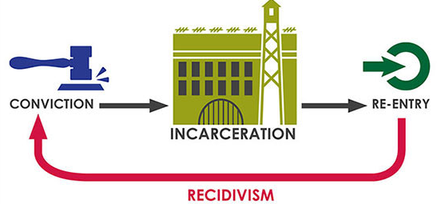
Louisiana’s Statistics on Recidivism
Louisiana reports that around 45 percent of Louisiana offenders will reoffend within five years of release. It is an expensive endeavor: An official estimate suggests that Louisiana spends $700 million annually on corrections.
Notes:
As a result of the Justice Reinvestment legislation passed in 2016, the Department of Public Safety and Corrections expects to see a tremendous reduction in cost and be able to pass that savings on to the reentry community.

Slide 14
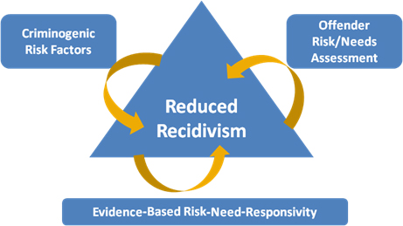
What Affects Recidivism?
What Can Community Providers do About it?

Slide 15
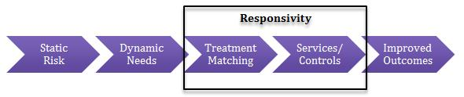
Risk, Need, Responsivity Model
The concepts of Risk‐Need‐Responsivity (RNR), originally developed in the 1980s, have gained increasing support across the nation and have recently been adopted by most Department of Corrections nation-wide.
Research indicates that the three principles can decrease the risk of recidivism for offenders when implemented correctly.
The three principles are as follows:
Risk Principle- identifies WHO to target
Need Principle- identifies WHAT to target
Responsivity Principle- identifies HOW to target
The RNR principles allow staff to make informed decisions on how to allocate resources to improve outcomes for the criminal justice population.
Principles of Recidivism Reduction, 2014
Notes:
Principles of Recidivism Reduction (2014). Retrieved June 5th, 2014 from: http://csgjusticecenter.org/reentry/principles‐of‐recidivism‐reduction.
Koetzle, D. & Skinner, B. (2014.) “Recidivism Reduction Training: Strategies for Promoting Staff Safety and Public Safety in Rhode Island.” Presentation at the Rhode Island Department of Corrections Recidivism Reduction Training, Cranston, RI, June 3 & 4, 2014.
Latessa, E.J. (n.d.) “What works and what doesn’t in reducing recidivism: applying the principles of effective intervention to offender reentry” PowerPoint Presentation. University of Cincinnati, Cincinnati, OH.

Slide 16
Risk Principle
Risk = How likely a person is to engage in criminal behaviors
  Match level of services to level of risk
  Risk does NOT refer to dangerousness or likelihood of violence
  Prioritize supervision and treatment resources for higher risk clients
    Higher risk clients need more intensive services
    Low risk clients require little to no intervention
    “If it ain’t broke, don’t fix it”
Prioritize primary supervision and treatment resources for offenders who are at higher risk to re-offend. Research shows that resources that are focused on low-risk offenders tend to produce little net positive effect on recidivism rates.
Notes:
Research shows that resources that are focused on low-risk offenders tend to produce little net positive effect on recidivism rates. Sometimes it can elevate the likelihood of that person recidivating.

Slide 17
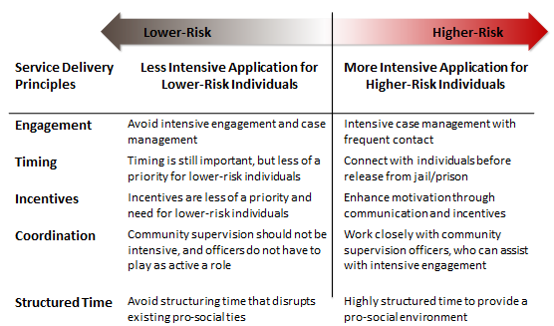
Service Delivery Principles- “How You Do It”
Based Primarily on Risk of Recidivism

Slide 18
Risk Principle tells us WHO to target …
… so now what do we DO?

Slide 19

Need Principle
Need = What areas in a person’s life should be targeted for intervention / supervision in order to decrease their likelihood of future criminal behavior
Assess criminogenic needs and target those needs with treatment and interventions.

Slide 20
Criminogenic??

Slide 21
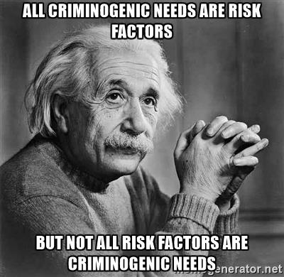
Criminogenic Needs
Dynamic or “changeable” risk factors that contribute to the likelihood that someone will commit a crime
Changes in these needs / risk factors are associated with changes in recidivism.
“People involved in the justice system have many needs deserving treatment, but not all of these needs are associated with criminal behavior.”
- Andrews & Bonta (2006)

Slide 22
‘Central Eight’ Risk Factors
Anti-social Attitudes
Anti-social Peers
Anti-social Personality Pattern
History of Anti-Social Behavior
These are knows as the “Big Four” Risk Factors
Most highly correlated with criminal behavior among all of the factors

Slide 23
‘Central Eight’ Risk Factors
Anti-social Attitudes
Anti-social Peers
Anti-social Personality Pattern
History of Anti-Social Behavior
Family / Marital Factors
Lack of Achievement in Education / Employment
Lack of Pro-social Leisure Activities
Substance Abuse

Slide 24
Fundamentals
Returning Citizens’ Services Investment
Recidivism Impact:
Treatment vs. Supervision and Surveillance
Intensive Supervision w/ community-based treatment -16.7%
Drug treatment in community -9.3%
Adult drug courts -8.0%
Employment and job training in the community -4.3%
Sex offender treatment in prison with aftercare -7.0%
Electronic monitoring 0%
Intensive supervision/surveillance 0%
Adult boot camps 0%
Washington State Institute for Public Policy; Evidence-Based Public Policy Options to Reduce Future Prison Construction, Criminal Justice Costs, and Crime Rates; October 2006

Slide 25
Developing Effective and Sustainable Community Collaborations to Improve Returning Citizen Outcomes
PART ONE
A State Level Framework for Reentry Reforms to Reduce Recidivism

Slide 26
Implementing Evidence Based Principals
Fundamentals of the LA-PRI
Implementing Evidence Based Principles
Organizational EBPs
Skill Train
Target Interventions
Engage Communities
Measure Performance
Feedback to the Field
Client Centered EBPs
Assess Risk
Assess Need
Positive Reinforcement
Target Interventions
Crime and Justice Institute at Community Resources for Justice (2009). Implementing Evidence-Based Policy and Practice in Community Corrections, 2nd ed. Washington, DC: National Institute of Corrections

Slide 27
Developing
Developing Effective and Sustainable Community Collaborations to Improve Returning Citizen Outcomes
The Transition from Prison to Community (TPC) Model
National Institute of Corrections
Developed to provide state-specific approaches to improve prisoner reentry.
The Model helps guide the improvement and expansion of existing policies for states.
Helps to address the complexity of the reentry process by breaking it down to three phases and seven decision points.
Requires Transitional Planning and the Use of Evidence-based Practices – two “overarching paradigms”.
TPC Reentry Handbook: Implementing the NIC Transition from Prison to the Community Model. Peggy Burke. Washington D.C.: U.S. Department of Justice. National Institute of Corrections, 2008

Slide 29
Best Practices in Transition Planning
Effective Transition Plans:
Prioritize returning citizen’s goals and include attainable milestones and are built for success.
Include post-release supervision requirements.
Are responsive and flexible to adjust to accomplishments and set backs.

Slide 30
The Four Step Transition Planning Process
STEP ONE
Prison-based assessments of risks, needs, strengths, and environment.
Transition Planning starts in prison with a comprehensive risk/need assessment that drives the Transition Planning Process.
The goal is to understand personal, situational, and historical/contextual factors behind each returning citizen’s criminal justice involvement, their risks, needs and strengths in order to mediate and manage risk and become successful in the community.
The assessment should be validated and measure risk and criminogenic need but should also include multiple screenings and further assessment, as indicated, for a full range of personal history and needs.

Slide 31
The Four Step Transition Planning Process
STEP ONE (CONT’D)
Prison-based assessments of risks, needs, strengths, and environment.
The Transition Plan is built in prison to manage risk and begin to address the returning citizen’s needs for community success, including but not limited to health, mental health, family relationships, employment, and housing stability.
The best Transition Plans are highly specific and include the schedule for activities.
Reassessment is needed throughout the entire reentry process. Reassessment allows the team to uncover new or evolving needs and to track changes in dynamic criminogenic needs following delivery of treatment, programming, and other interventions.

Slide 32
The Four Step Transition Planning Process
STEP TWO
Form, participate in, and lead Transition Management Teams that work collaboratively.
Throughout all three phases of reentry, transition planning and management activities are conducted by an interdisciplinary team called a Transition Management Team.
The composition of the success team and the respective roles of its members will change over time, as the returning citizen completes goals, identifies new needs, and transitions through the three phases.

Slide 33
The Four Step Transition Planning Process
STEP TWO (CONT’D)
Form, participate in, and lead Transition management teams that work collaboratively.
Generally, the team should include the returning citizen, prison staff, community supervision staff, facility and community-based service providers, and family members and/or pro-social supports.
During the institutional phase prison staff may lead the team. During the reentry and community supervision phase parole officers may lead the team. During the reintegration phase human services agencies or community services providers may lead the team.

Slide 34
The Four Step Transition Planning Process
STEP THREE
Develop and implement with returning citizens, human service agencies and justice officials a Transition plan directed specifically to the level of risk and criminogenic needs.
Provide or facilitate access to programs and interventions to address risk and needs.
In addition to the role members of the success team will play in delivering direct services, including assessment, treatment, and motivational enhancement, at various points, the success team will also fill a referral and brokerage role.
The two complimentary roles ensure that returning citizens have access to treatment, programming, and interventions that will effectively address risk and needs. Interventions should be consistent with the principles of evidence-based practice.

Slide 35
The Four Step Transition Planning Process
STEP FOUR
Review progress and adapt plans accordingly over time, including monitoring conditions of supervision and responding appropriately to technical and criminal violations.
When indications of sliding back toward old problematic behavior patterns, a swift response to identify the problem and adjust the plan accordingly is needed.
Conversely, faster than expected progress, compliance with expectations and other achievements should be acknowledged and rewarded to enhance motivation.
The Transition Management Team’s focus on monitoring and adjusting the transition plan is especially important in the period immediately following return to the community when anxiety and stress require an adjustment period.

Slide 36
The Four Step Transition Planning Process
STEP FOUR (CONT’D)
Review progress and adapt plans accordingly over time, including monitoring conditions of supervision and responding appropriately to both technical and criminal violations.
It is important that community supervision officers have the skills to distinguish between the behaviors that are affiliated with a risk of future transgression and behaviors that are more likely associated with the adjustment.
The success team should be equipped with a full range of responses, including graduated levels of sanctions, that can be used to facilitate compliance and encourage success.

Slide 37
Evidence-Based Practices Lead to Better Outcomes
Most Effective:
Cognitive Processing
Cognitive Behavioral (Social Skills, Behavioral Management, etc.)
Therapeutic Communities (TC)
Contingency Management/Token Economies
Drug Courts
RNR Supervision
In-Prison TC with Aftercare
Moderately Effective:
Motivational Interviewing
Moral Reasoning
Emotional Skills
12 Step with Curriculum
TASC
DTAP (Diversion to TX, 12 Month Residential)
Treatment with Sanctions (e.g. Break the Cycle, Seamless System, etc.)
Least Effective:
Education (Psycho-Social)
Non-Directive Counseling
Directive Counseling
Intensive Supervision
Boot Camp
Case Management
Incarceration
Principles of drug abuse treatment for criminal justice populations: A research based guide
Notes:
National Institute on Drug Abuse. (2006). Principles of drug abuse treatment for criminal justice populations: A research based guide. Rockville, MD: National Institutes of Health.
Warren, R., and Crime and Justice Institute. 2007. Evidence-Based Practice to Reduce Recidivism: Implications for State Judiciaries. Washington, DC: U.S. Department of Justice, National Institute of Corrections.

Slide 38
Evidence-based Cognitive Behavioral Programs to Reduce Recidivism
Moral Reconation Therapy (MRT) is a cognitive-behavioral program for substance abuse treatment and for criminal justice offenders. MRT addresses beliefs and reasoning. It is a systematic, step-by-step group counseling treatment approach for treatment-resistant clients. The program is designed to alter how clients think and make judgments about what is right and wrong.
Thinking for a Change 4.0 (T4C) is an integrated cognitive behavioral change program. T4C uses a combination of approaches to increase offenders’ awareness of themselves and others by integrating cognitive restructuring, social skills, and problem solving skills.
The Reasoning & Rehabilitation (R&R) program is an cognitive-behavioral program for teaching the cognitive skills, social skills and values that are required for prosocial competence.

Slide 39
What Doesn’t Work!
Famous Programs Based On Flawed Theories/Models
  Scared Straight – deterrence theory; “make them fear prison.”
  Nearly every study over the past 25 years has found dismal results, many even showing higher recidivism rates for Scared Straight participants. Has been characterized as criminal justice malpractice.
Drug Abuse Resistance Education (DARE) – didactic model; “kids don’t know drugs are bad for them.”
  Most studies have found neutral effects for DARE. More recent versions of DARE, based upon cognitive-behavioral principles, have been more promising
Sheriff Joe Arpaio’s (Maricopa County Jail, Arizona) Tent Cities and Chain Gangs – more deterrence theory; “make them hate prison.”
  By the jail’s own admission, its recidivism rate exceeds 60 percent.
Latessa, What Works and What Doesn’t in Reducing Recidivism: Applying the Principles of Effective Intervention to Offender Reentry
Notes:
Latessa, E.J. (n.d.) “What works and what doesn’t in reducing recidivism: applying the principles of effective intervention to offender reentry” PowerPoint Presentation. University of Cincinnati, Cincinnati, OH.

Slide 40
The Challenges Of Implementing Effective Interventions
Requires a dedicated commitment to change by managers, line staff, and everyone in between
  Not just in corrections agencies, but in all service delivery agencies
Requires an increased emphasis on accountability for our work – individual and collective
Requires us to reconsider current practices and let go of the “that’s always how we’ve done it” philosophy
Requires us to confront and address resistance

Slide 41
Important Considerations
Offender assessment is the engine that drives effective programs and helps you know who/what to target
Design programs around empirical research (helps you know how to effectively target offenders)
Program integrity makes a difference
  Service delivery, training/supervision of staff, support for program, QA, evaluation, track results
  FIDELITY, FIDELITY, FIDELITY

Slide 42

Questions?
Bibliography and/or copy of presentation available upon request.
Email: james.windom@caparc.org
Point of view or opinions in this presentation are those of the author and do not represent the official position or policies of the Louisiana Department of Public Safety and Corrections. Information given was based from recent research findings provided in the correlating Bibliography.

Slide 43
Resources
D.A. Andrews and James Bonta, “ColorPlot Profile Form for Men,” The Level of Service Inventory - Revised: U.S. Norms, (North Tonawanda: Multi-Health Systems, Inc., 2003).
Don Stemen, Vera Institute of Justice, Reconsidering Incarceration: New Directions for Reducing Crime 13-14 (2007).
Durose, Matthew R., Alexia D. Cooper, and Howard N. Snyder, Recidivism of Prisoners Released in 30 States in 2005: Patterns from 2005 to 2010 (pdf, 31 pages), Bureau of Justice Statistics Special Report, April 2014, NCJ 244205.
Koetzle, D. & Skinner, B. (2014.) “Recidivism Reduction Training: Strategies for Promoting Staff Safety and Public Safety in Rhode Island.” Presentation at the Rhode Island Department of Corrections Recidivism Reduction Training, Cranston, RI, June 3 & 4, 2014.
"National Information on Offender Assessments Part II." Illinois Risk, Assets and Needs Assessment Task Force. Vera Institute of Justice, Center on Sentencing and Corrections, 27 May 2010. Web. 15 Mar. 2017.
National Institute of Justice. "Recidivism." National Institute of Justice, 17 June 2014. Web. 1 Mar. 2017.

Slide 44
Resources Cont.
Latessa, E.J. (n.d.) “What works and what doesn’t in reducing recidivism: applying the principles of effective intervention to offender reentry” PowerPoint Presentation. University of Cincinnati, Cincinnati, OH.
McCollister, K.E., French, M.T., and Fang, H. (2010). The Cost of Crime to Society: New Crime-Specific Estimates for Policy and Program Evaluation. Drug and Alcohol Dependence, 108, 98-109
National Institute of Corrections. "Transition from Prison to Community (TPC)."NICIC.gov: Transition from Prison to Community (TPC). National Institute of Corrections, 2010. Web. 15 Mar. 2017.
National Institute on Drug Abuse. (2006). Principles of drug abuse treatment for criminal justice populations: A research based guide. Rockville, MD: National Institutes of Health.
Principles of Recidivism Reduction (2014). Retrieved June 5th, 2014 from: http://csgjusticecenter.org/reentry/principles‐of‐recidivism‐reduction.
Stephanie Lee, Steve Aos, Elizabeth Drake, Annie Pennucci, Marna Miller, Laurie Anderson, “Return on Investment: Evidence-Based Options to Improve Statewide Outcomes,” (Olympia: Washington State Institute for Public Policy, April 2012);
Warren, R., and Crime and Justice Institute. 2007. Evidence-Based Practice to Reduce Recidivism: Implications for State Judiciaries. Washington, DC: U.S. Department of Justice, National Institute of Corrections.

