Slide 1
The State of Reentry: The Facts

Slide 2
Incarceration rips families apart, creates arrest records, and can leave a lifetime of emotional and psychological scars.
Successful reintegration…can make neighborhoods and families safer and more stable.
Integrated Reentry and Employment Strategies, Justice Center The Council of State Governments, Bureau of Justice Assistance, and The Annie E. Casey foundation. September 2013
“67 percent majority agrees that "building more jails and prisons to keep more people in jail does not reduce crime," including 61 percent of rural Americans. ”
The Economics of Incarceration:
The Evolving Landscape of Crime and Incarceration by Greenberg Quinlan Rosner Research, April, 2018.

Slide 3
What is Recidivism?
The definition of recidivism—whether it’s re-arrest, reconviction, or re-incarceration—and the methodologies used to calculate it vary from state to state and at the local level.
The Complexity of Measuring Recidivism
There is no monolithic, nationwide corrections system
Fewer than one in three states track recidivism for the 3.7 million people on probation
Making People’s Transition from Prison and Jail to the Community Safe and Successful: A Snapshot of National Progress in Reentry
June 2017

Slide 4
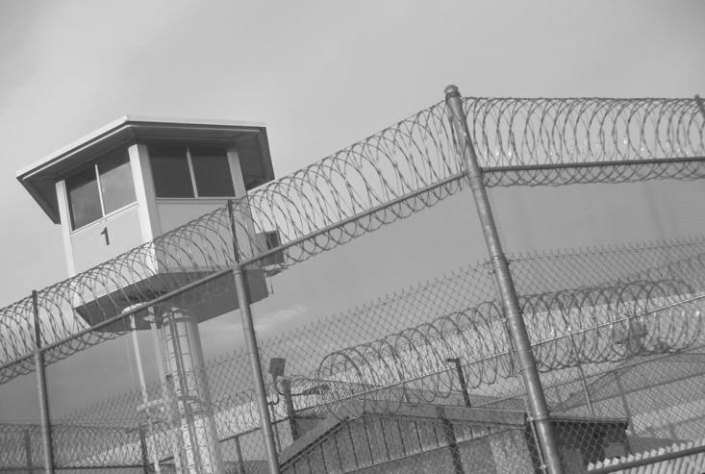
National
Facts and Trends

Slide 5
As of 2012: Still over 2 million people incarcerated in prisons and jails across the country.
Source: “Offender Reentry: Correctional Statistics, Reintegration into the Community, and Recidivism,” The Congressional Research Service
The American criminal justice system holds almost
2.3 million people in:
1,719 state prisons
102 federal prison
1,852 juvenile correctional facilities
3,163 local jails
80 Indian Country jails as well as in military prisons, immigration detention facilities, civil commitment centers, state psychiatric hospitals, and prisons in the U.S. territories.
Mass Incarceration: The Whole Pie 2018; Prison Policy Initiative

Slide 6
BUREAU OF JUSTICE STATISTICS, May 23, 2018
5 OUT OF 6 STATE PRISONERS WERE ARRESTED AT LEAST ONCE WITHIN 9 YEARS OF THEIR RELEASE.
Overall,
68 % of released state prisoners were arrested within three years,
79 % within six years
83 % within nine years.
(Data came from prisoners released in 2005 and tracked to 2014)

Slide 7
Making People’s Transition from Prison and Jail to the Community Safe and Successful: A Snapshot of National Progress in Reentry June 2017
In 2016 and 2017, nearly half of U.S. governors cited reentry and reducing recidivism as ongoing efforts or future priorities in State
of the State addresses.
La Gov. John Bel Edwards was among them.

Slide 8
NATIONAL REENTRY RESOURCE CENTER 2017
6,840,000
2.3 million
95%
1 in 5
The number of people controlled by the US Justice system, more than 50% on probation
The number of people locked up on any given day giving this nation the dubious distinction of having the highest incarceration rate in the world
Released into their own communities at some point
The number of incarcerated people locked up for drug offense

Slide 9
NATIONAL REENTRY RESOURCE CENTER 2017
About 50%
$28,000
60%
Over 25%
Re-arrested within 5 years
Annual average amount to house one prison inmate
Non-violent offenders
(prison and jail population)
American population with a criminal record

Slide 10
NATIONAL REENTRY RESOURCE CENTER Facts & Trends
State
Facts and Trends

Slide 11
Associated Press - Thursday, March 16, 2017
Louisiana:
Highest per capita incarceration rate in the United States:
816 people in prison for every 100,000 residents (nearly double the national average).
Nearly 35,700 people are incarcerated today.
The number of prisoners has grown 30 times faster than the state’s population since the late 1970s.
One in three people return to prison in Louisiana within three years of release.

Slide 12
Louisiana Department of Public Safety and Corrections December 31,2017 Fact Sheet
2011: Louisiana housed 39,709 adult inmates
2014: 3 year recidivism rate was 35.1%
5th year recidivism rate was 44.3%
2015: 72,176 under probation & parole supervision
2017: Louisiana housed 33,739 adult inmates
31,782 Male Population
1,957 Female Population
4,824 Lifer Population
(73.9% Black; 25.6% white)
2017: 293 Youth offender housed in DOC facilities

Slide 13
http://nolayouth.org/wp-content/files/Black_Men_and_Boys_Final_Report_March_15_2010.pdf; “The War on Marijuana in Black and White” June, 2013.
Black Louisiana males had been incarcerated during their lifetime
Black men that were born in 1965 have a prison record
In 2010, 21% of Louisiana black males between the ages of 19 and 64 currently either incarcerated or under probation or parole supervision.
Number arrested for marijuana in 2013
More Black than White arrest for marijuana in 2013
Black males born in 2010 will spend time in prison in their life time
1 out of 6
65%
21%
13,000
11 times
1 out of 3

Slide 14
Local Facts and Trends

Slide 15
Recidivism Rate by Parish
Southwest Central Region recidivism rate 52.4%
Vermillion Parish 53.9%

Slide 16
St. Mary, St. Martin and Iberia Parishes are part of the New Iberia District and is located in the Southwest Central Region of the DOC state map. Vermillion Parish is located in the Southwest Central Region but FIPs are sent to Lafayette District Probation & Parole. _________________
3 Parish Data
Probation & Parole (3,200 FIP cases)
1,950 Probation cases
1250 Parole & Good Time
15 Specialized Sex Offenders
162 Sex Offenders
Data Source: La Department of Corrections

Slide 17
3 Parish Data Disaggregation of data
Gender
Probation:
22% Female
78% Male
Parole:
8% Female
92% Male
Ethnicity
Probation:
White 46% Black 52% Other 1%
Parole cases: White 30% Black 69% Other 1%

Slide 18
Disaggregation of data (3 Parishes)
Gender
Probation:
22% Female
78% Male
Parole:
8% Female
92% Male
Ethnicty
Probation:
White 46% Black 52% Other 1%
Parole cases: White 30% Black 69% Other 1%

Slide 19
Source of Data
THE ROAD TO SUCCESSFULLY
RETURNING OUR CITIZENS
M
O
V
I
N
G
F
O
R
W
A
R
D

Slide 20
Major categories to successful reentry producing positive outcomes.
Identify non-profits and community organizations who provide:
Housing
Education
Technical & Soft Skills Training
Employment
Health & Wellness Services
Transportation
Basic Needs: food, clothing, etc.
Parenting Skills
Family reunification
Legal Assistance
Notes:
There is a body of evidence being built to support positive results.

Slide 21
For additional information about reentry, resources and partners by region, research and weekly updates from across the state, go to the
ReEntry Alliance for Louisiana’s website
www.reentryalliancela.org

